Slide 1

Program Design
Final Report
Ginger Soda
薑汁汽水
Member: 410410045 林鈺琁
410420053 林祖葳
410420056 陳玟伶
410420121 何莉華
411422047 高可欣
11 June, 2024

Slide 2
Game
introduction

Slide 3

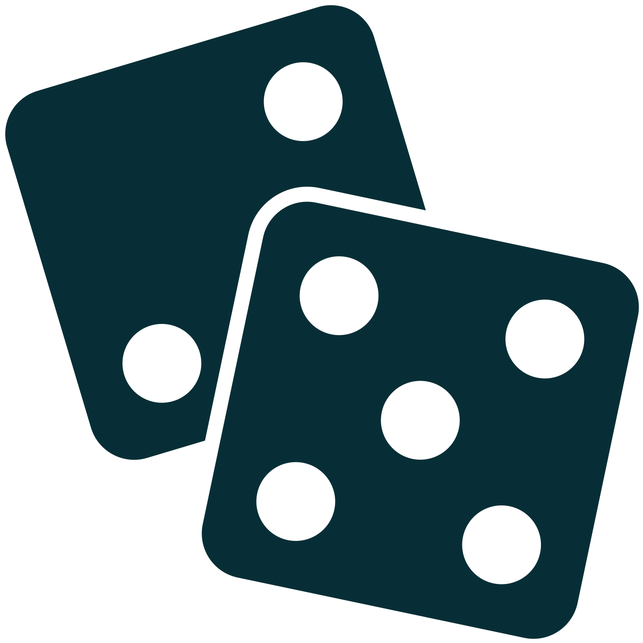


Who
Players: 2.
Players roll the dice and advance on the board according to the points rolled.
How
Gameplay
(Monopoly)
Various events to the squares the players getting money or “GINGER SODAS.”
What
Wining Condition: Compare the number of “GINGER SODAS” when game rounds end.
When

Slide 4



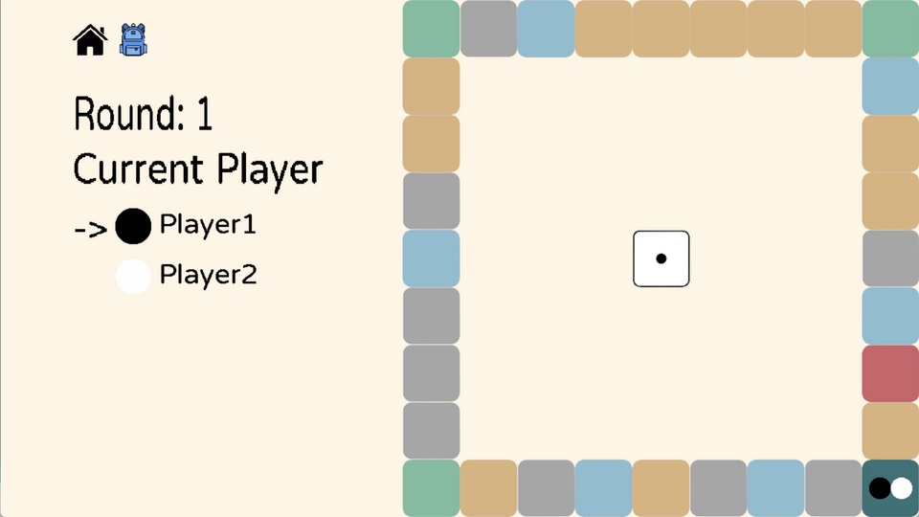




Different colors correspond to different squares.
Map will be randomly regenerated each time the game is replayed.
Board in Map
Normal Square
Game Square
Nothing happened
Play different mini-games
Chance Square
Vending Machine
Various events based on players’ fortune
Get "GINGER SODA"
Start Square
Store Square
The beginning square
Buy tools

Slide 5
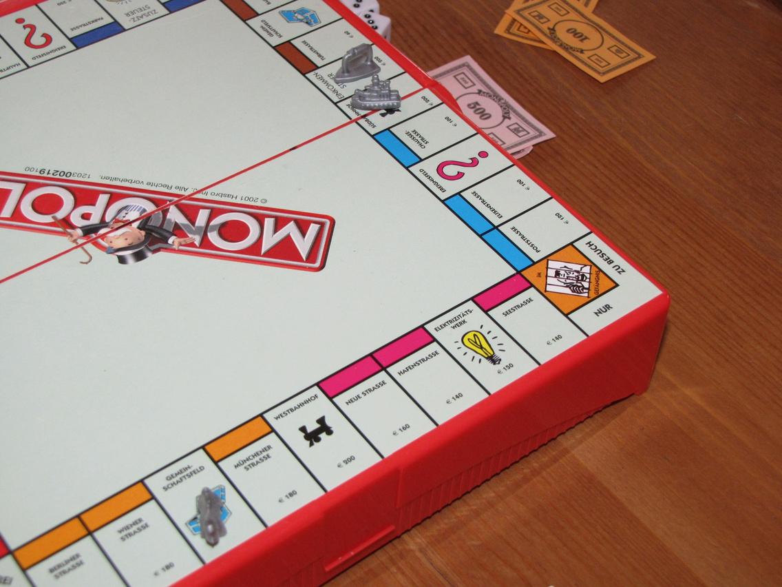
Game Made
Basic: C program
Event: C++ program
Game Engine: SDL

Slide 6
Basic Part

Slide 7


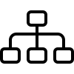
int: players-2, money
bool: show_cursor in input bar
float: time
basic data types
Data Types
description of tools,
players’ name
question of events
string type
struct: Players’ information
enum: Type of tools
data structure

Slide 8
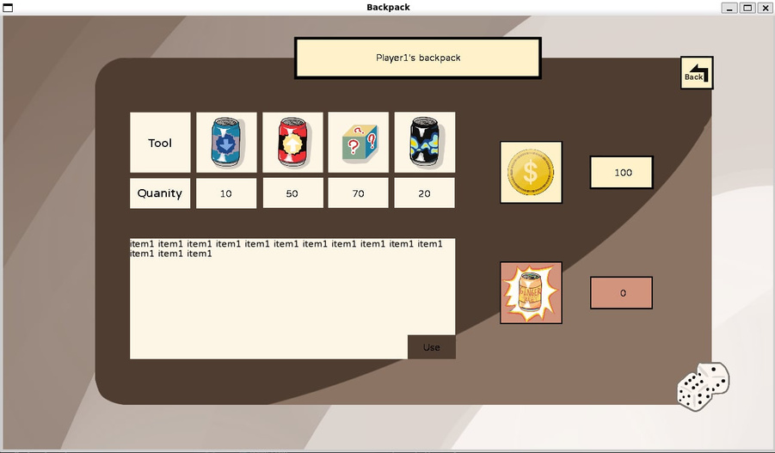
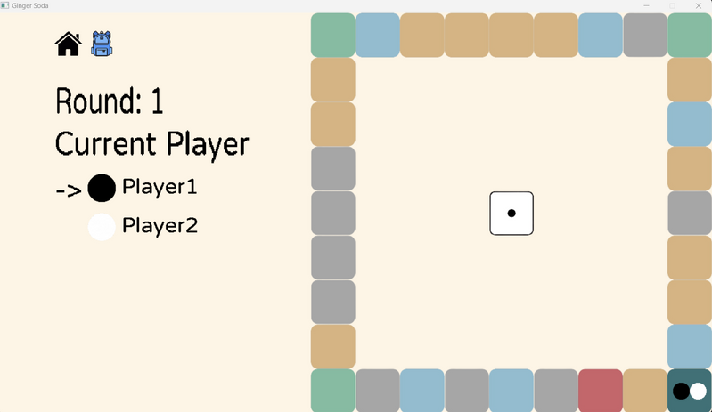
Operations
Traverse - Backpack
Sort - type of Screen
the number of player’s tools
the amount of player’s money
the number of player’s ginger soda
Menu screen
Game screen
Backpack screen
Store screen
Chance screen

Slide 9
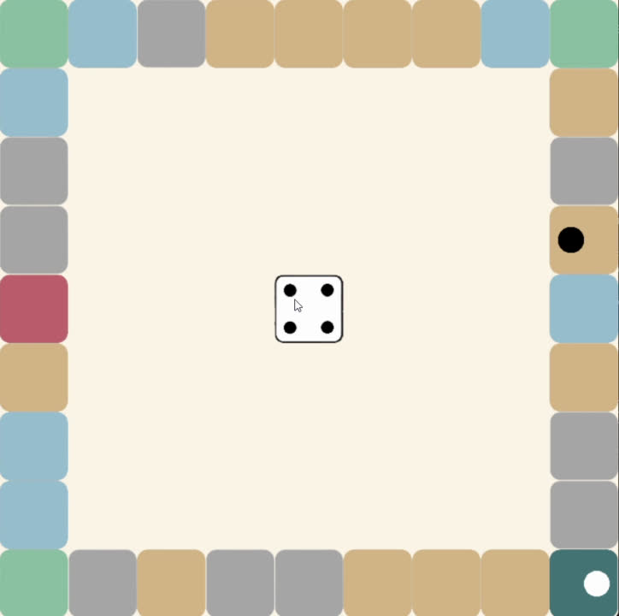
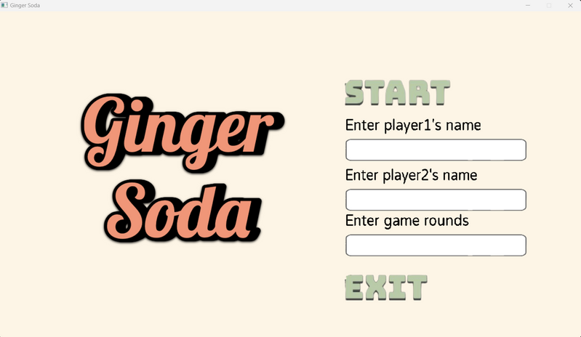
Operations
Random
File I/O
event
dice
unknown soda
Map square
players can input their name in input bar

Slide 10
Advanced Part

Slide 11
Backpack
Player can check the items he or she owns in the backpack.
including, tools, money and ginger soda.
player can use the tools in the backpack according to the description of the tooi

Slide 12
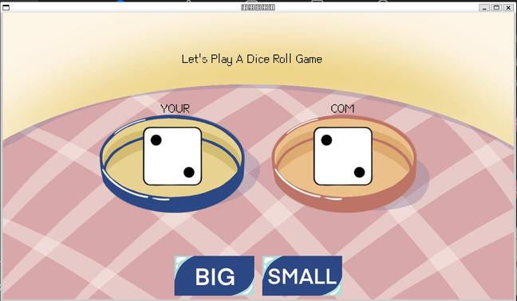
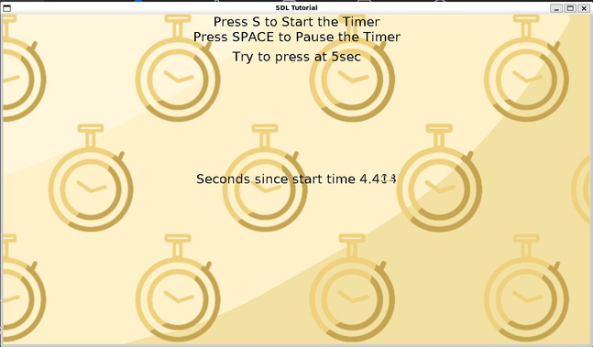
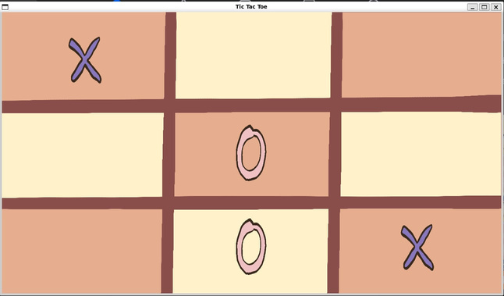
Mini Game
the square for playing mini-game
Dice Comparison
Timer Challenge
Tic-tac-toe

Slide 13
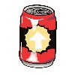
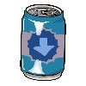
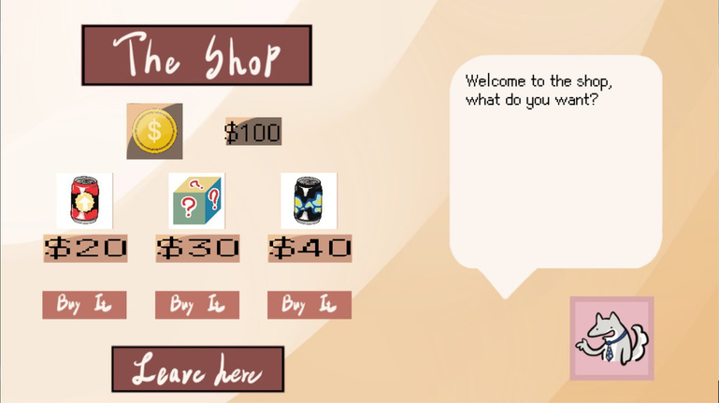
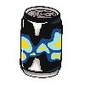

Store
the square for buying tools
Increase Soda
Decrease Soda
Increase player 2 steps .
decrease opponent 2 steps.
Gamble Roulette
Unknown Soda
2% Chance of Bankrupting opponent.
Put special Effects (lucky or unlucky) for the player or opponent.

Slide 14
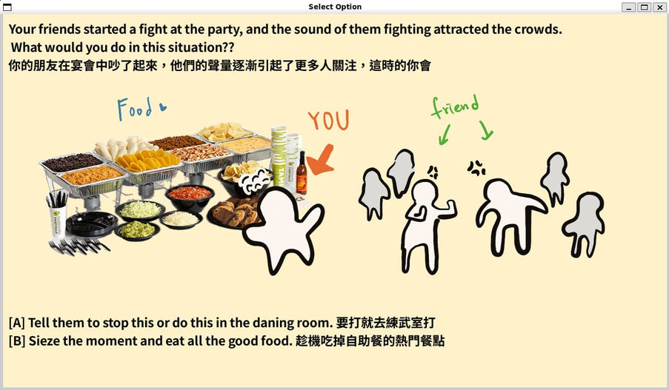
Advance Part - Event
the square for chance
the player’s items, including money and ginger soda, will increase or decrease.
it will be lucky or unlucky.
totally 8 events.

Slide 15
Task allocation
林鈺琁：地圖框架生成、主菜單畫面
林祖葳：小遊戲（骰子比大小）、商店
陳玟伶：玩家介面（背包）、期中期末簡報
何莉華：整合成畫面、期中期末報告口頭
高可欣：小遊戲（讀秒遊戲、井字遊戲)、事件、期中報告口頭

Slide 16
Program Demo

Slide 17
Thank you

